Slide 1
Online
Bakery System
Team members:
Kariem Abdelmoniem
Abdelrahman Mohamed
Ahmed Mohamed Nabil
Bassem Baraket-allah

Slide 2
Table of contents
01
02
INTRODUCTION
Project Goals & Objectives:
03
04
Technology Stack
User Interface (UI)
05
06
System Architecture
Related Diagrams

Slide 3
Introduction
Our project is an online shopping platform facilitating user registration and login for customers, administrators, and delivery personnel. It offers comprehensive product management, seamless shopping cart functionality, and efficient order processing, ensuring a user-friendly experience and effective feedback collection for continuous improvement.

Slide 4

Project Goals & Objectives:
Create an functional bakery online shopping platform for all users.
Optimize processes for efficiency and effective management.
Gather feedback for continuous improvement.
Design a scalable and secure infrastructure.

Slide 5
Technology Stack
1 - Frontend :
HTML/CSS/JavaScript: For building the user interface and handling client-side interactions.
2 - Backend :
ASP.NET Core: A cross-platform for building web API
C#: A versatile and powerful programming language
Entity Framework Core: An ORM framework
Database: Sql Server
3 -Authentication & Authorization:
JSON Web Tokens (JWT): For securely transmitting information between parties as a JSON object.
4 -Version Controlling :
Git & GitHub

Slide 6
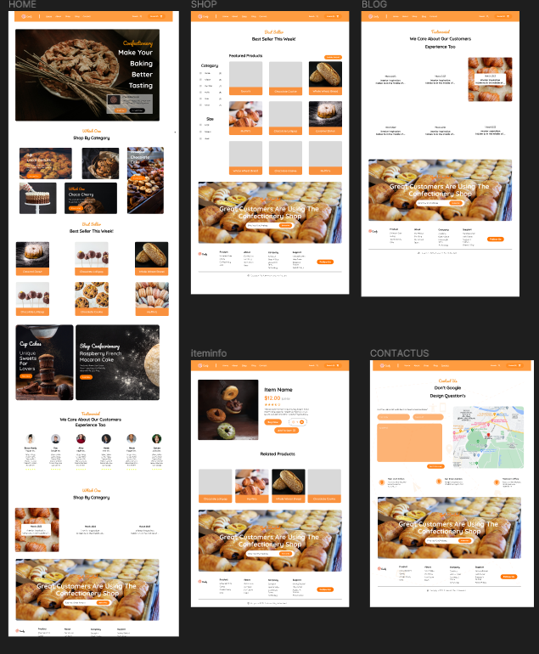
User Interface (UI)

Slide 7
System Architecture
2. Application Layer:
Logic tier handling business processes.
Modules include authentication, product management, order processing .
Implemented using ASP.NET for backend logic.
3. Data Layer:
Stores persistent data such as customer details, product inventory, and orders.
Includes a relational database (sql server)
Presentation Layer:
User interfaces for customers and bakery staff.
Implemented using HTML, CSS, and JavaScript.
Interaction Between Components:
Customers interact with the presentation layer, which sends requests to the application layer.
The application layer processes requests, interacts with the data layer, and sends responses back to the presentation layer.
This architecture ensures scalability, maintainability, and security for our online bakery system.

Slide 8
Related Diagrams
The Presentation Layer:
powered by HTML, CSS, and JavaScript, forms the user-facing aspect of our online bakery system.
HTML: Provides the structural foundation, defining the layout and content of web pages.
CSS: Enhances presentation, styling HTML elements to create visually appealing interfaces and ensure consistency across pages.
JavaScript: Enables dynamic and interactive features, handling client-side interactions such as form validation, animation effects, and asynchronous requests to the server.

Slide 9
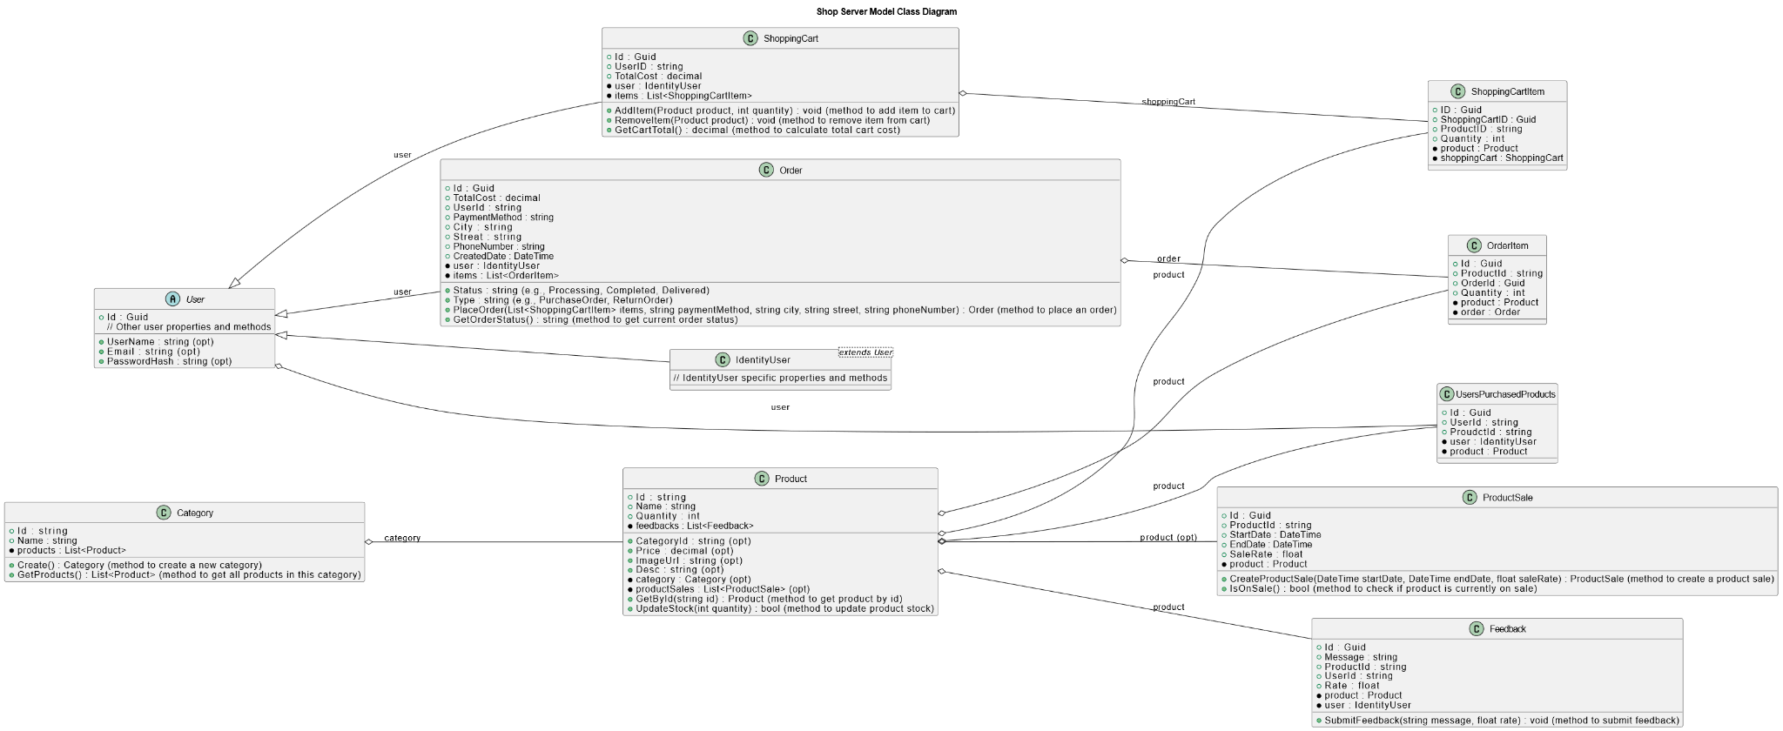
Related Diagrams
The Application Layer of our online bakery system acts as the engine that drives critical business operations.
Authentication Module: Ensures secure access to the system by managing user authentication and authorization processes, safeguarding sensitive data.
Product Management Module: Facilitates seamless management of the bakery's product inventory, enabling administrators to add, update, and remove products with ease, ensuring accurate and up-to-date information for customers.
Order Processing Module: Orchestrates the entire order lifecycle, from placement to fulfillment, streamlining payment processing, and order tracking for enhanced customer satisfaction.

Slide 10
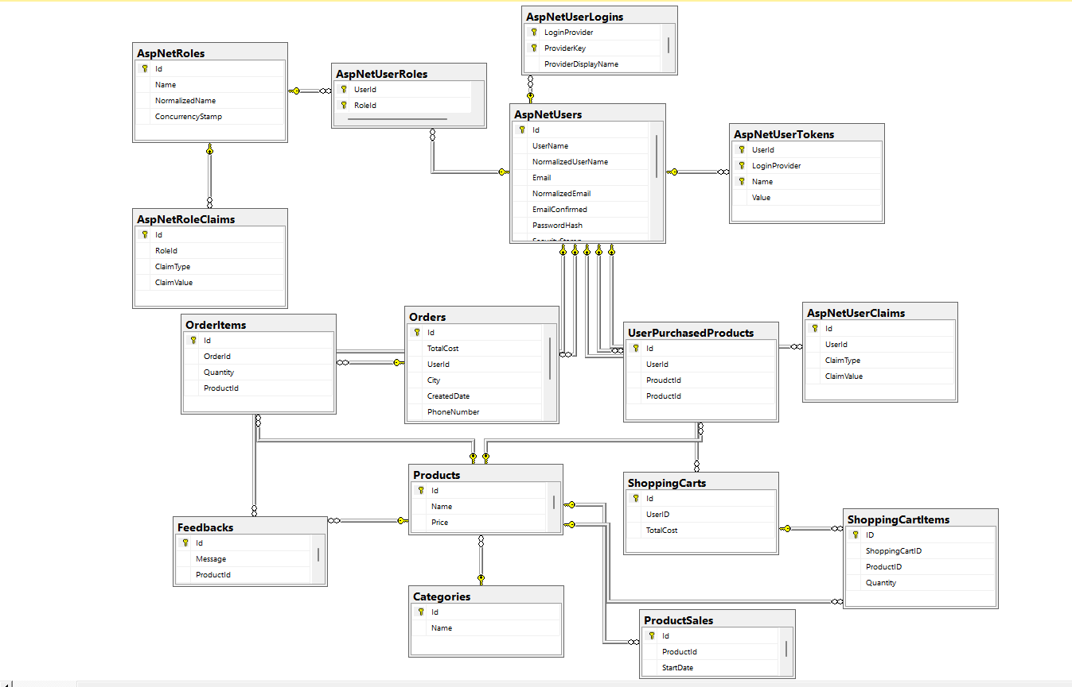
Related Diagrams
The Data Layer serves as the repository for crucial information in our online bakery system, housing persistent data essential for operations.
SQL Server Database: Our data layer employs SQL Server, a robust relational database management system.
Data Storage and Management: SQL Server efficiently stores and manages customer details, product inventory, and order records.
Scalability and Reliability: Leveraging SQL Server's scalability features, our data layer ensures seamless operation and data integrity, even with increasing data volumes and user loads.

Slide 11
Live Test

